Slide 1



Indian Agriculture
Analysis

Slide 2
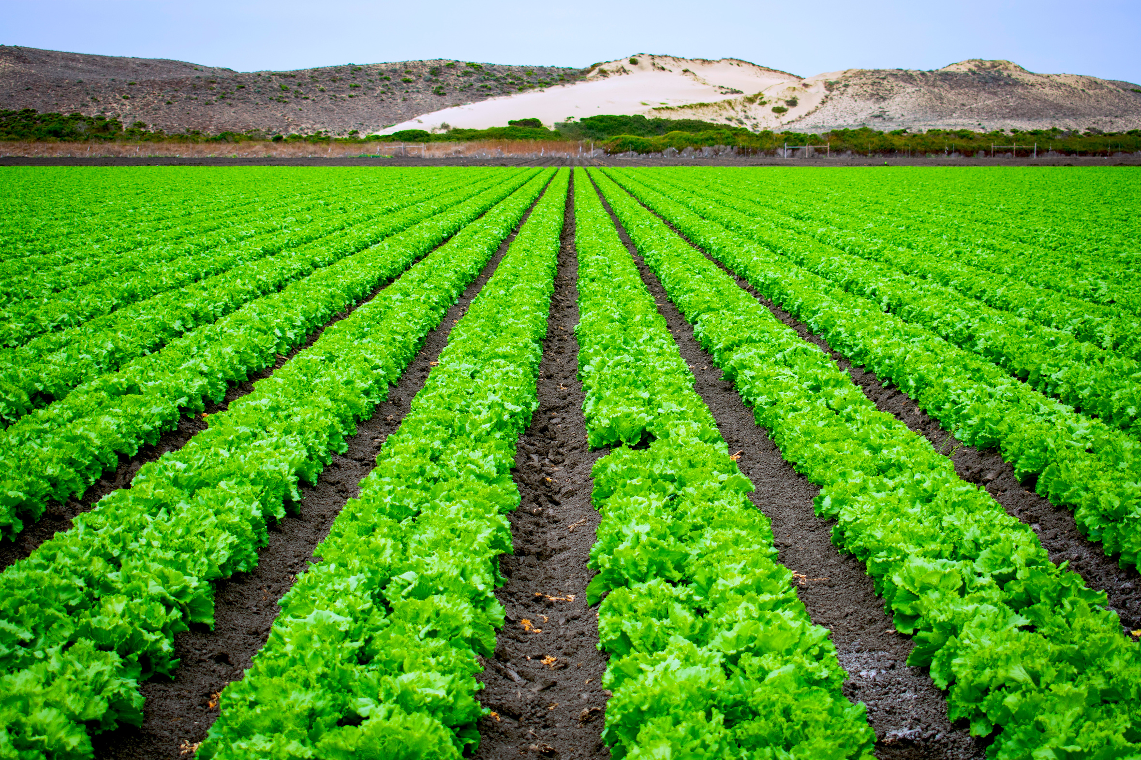
INTRODUCTION
The Indian Agriculture Analysis Dashboard in Power BI offers a comprehensive insight into the agricultural landscape of India. Drawing data from authoritative sources such as government reports and surveys, this dashboard provides a holistic view of key metrics including crop production, land utilization, and yield trends across different regions. Users can navigate through interactive visualizations to uncover patterns, compare data across time periods, and explore regional variations. With features like slicers and filters, stakeholders can customize their view to focus on specific crops, regions, or timeframes. This dashboard not only facilitates informed decision-making for policymakers, researchers, and stakeholders but also serves as a valuable tool for understanding the complexities and dynamics of Indian agriculture.

Slide 3
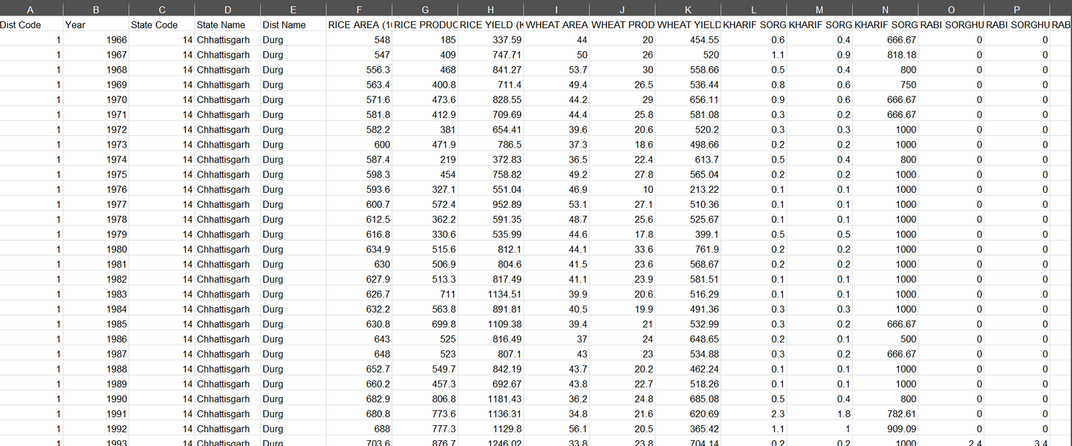
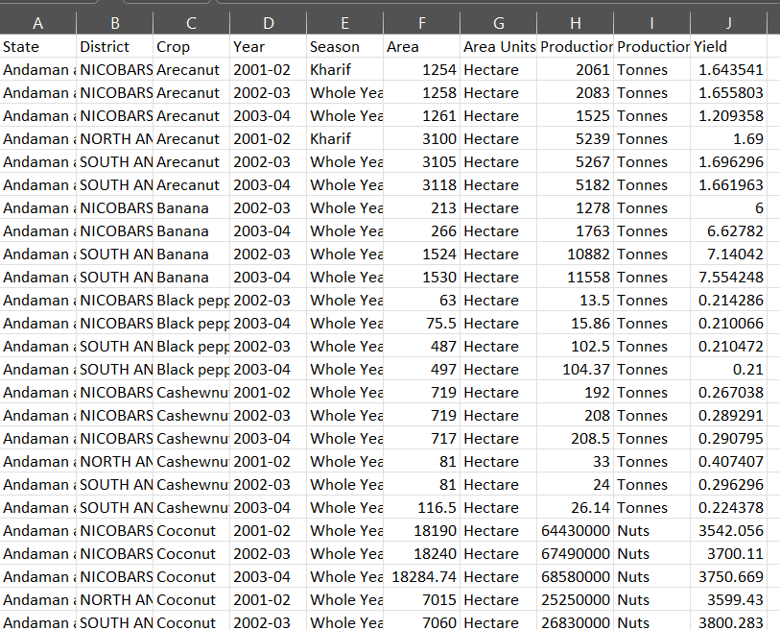
DATASET 1: ICRISAT District level data
DATASET 2: Indian Crop Production

Slide 4

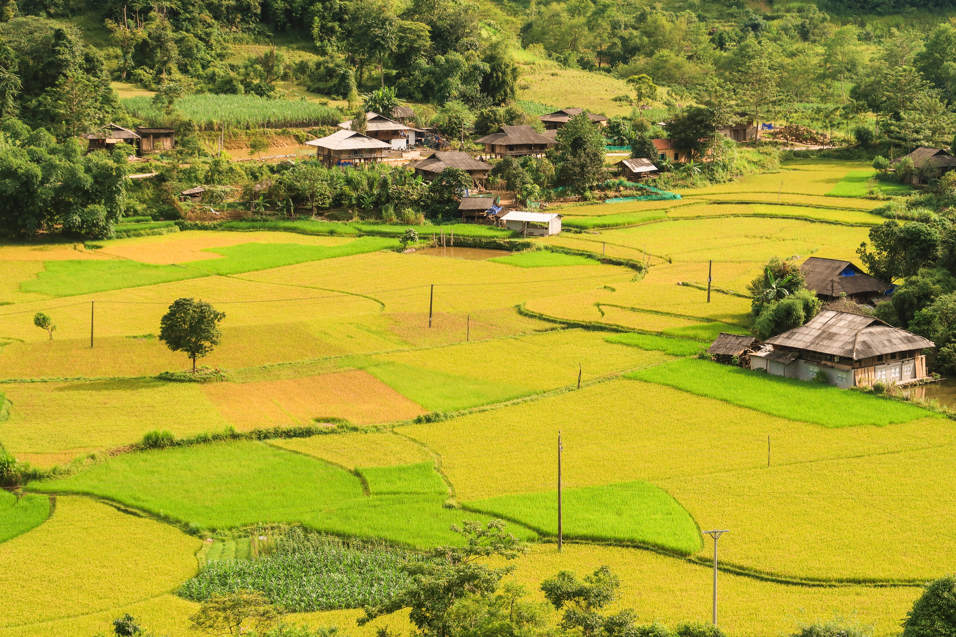

DASHBOARD

Slide 5

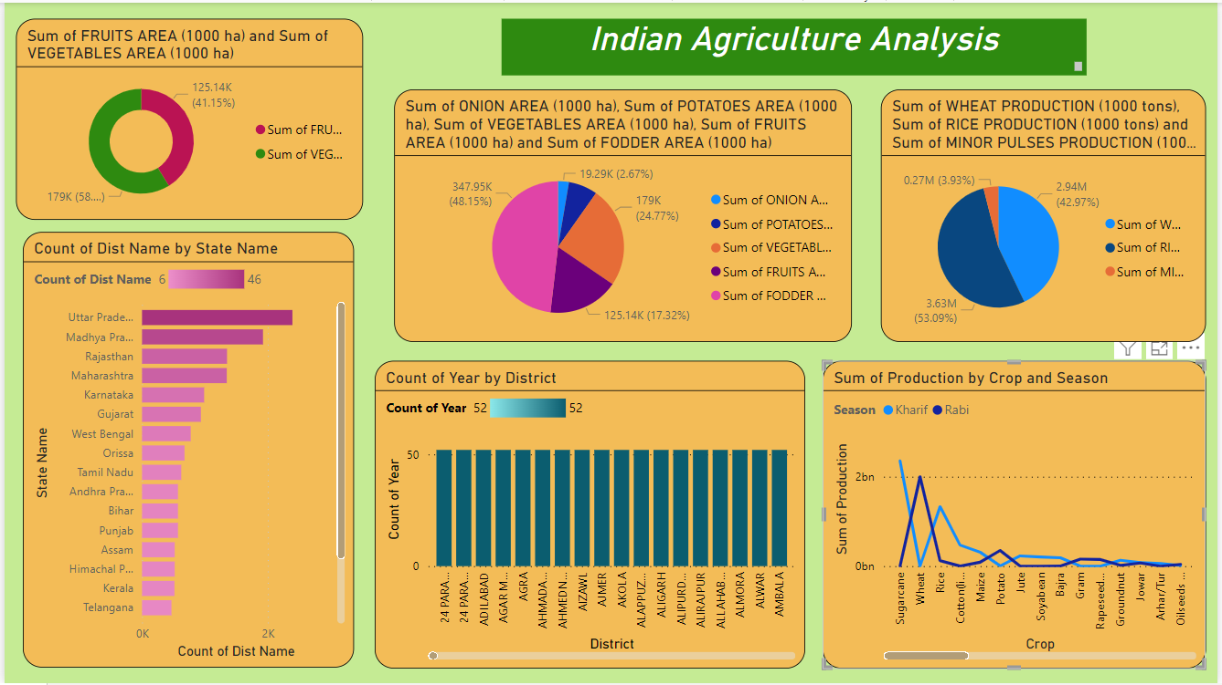

Slide 6
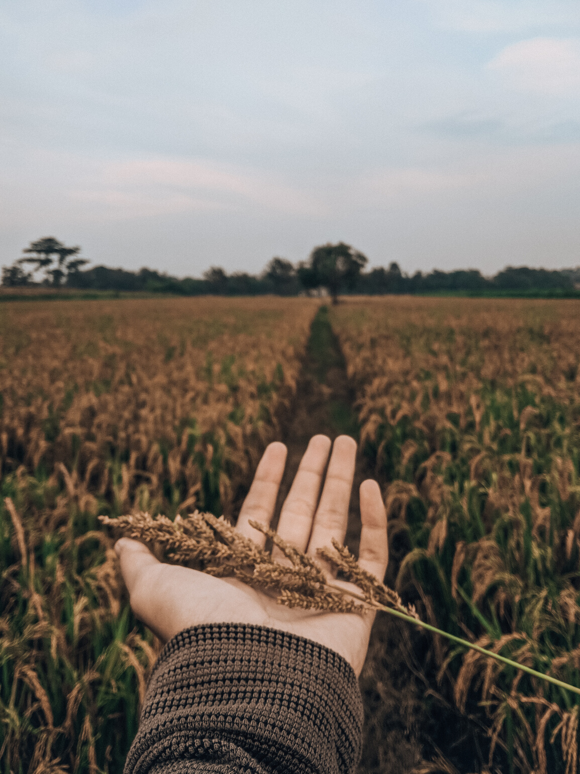
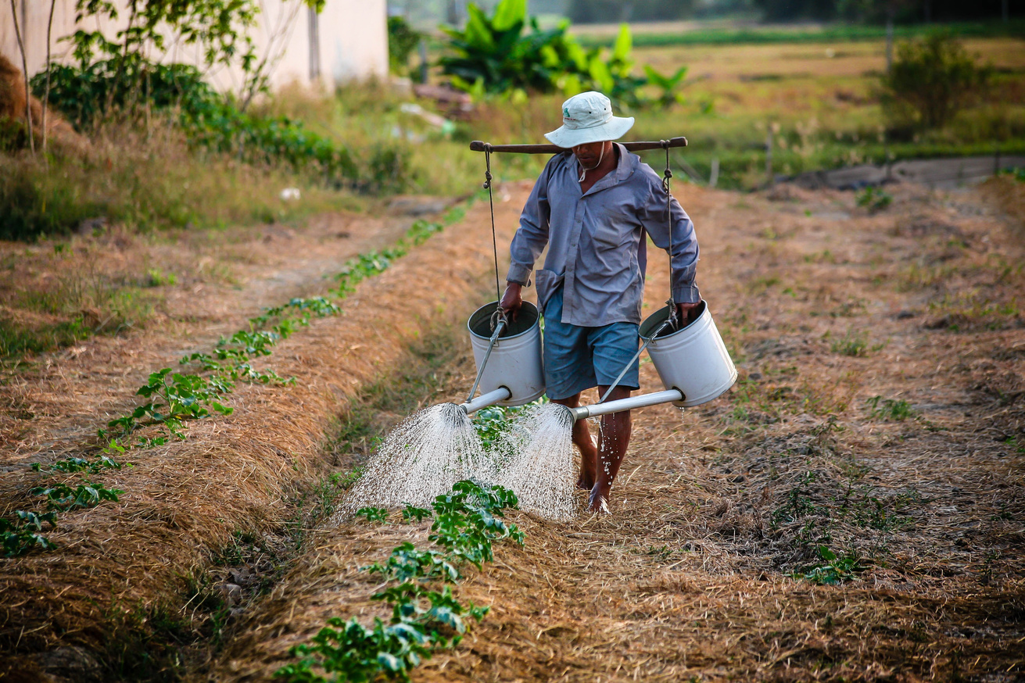
APPLICATIONS
Policy Making: Helps government agencies monitor policies, assess impacts, and allocate resources effectively.
Agribusinesses: Facilitates market trend analysis, supply chain optimization, and product development decisions.
Farmers: Provides access to crop prices, weather forecasts, and best practices for improved productivity and decision-making.
Research and Academia: Enables empirical studies on agricultural trends, climate change impacts, and regional variations.
Investors and Financial Institutions: Assists in assessing investment opportunities, managing portfolios, and evaluating project viability.
NGOs and Development Organizations: Supports targeted interventions for sustainable agriculture, food security, and rural development.

Slide 7


CONCLUSION
The Indian Agriculture Analysis Dashboard in Power BI serves as a versatile tool with far-reaching implications across various sectors. By providing actionable insights into agricultural trends, market dynamics, and productivity metrics, it empowers policymakers, agribusinesses, farmers, researchers, investors, NGOs, and development organizations to make informed decisions and drive impactful interventions. With its ability to facilitate evidence-based policy formulation, optimize resource allocation, and enhance productivity and sustainability in the agricultural sector, the dashboard plays a crucial role in advancing India's agricultural landscape towards greater efficiency, resilience, and socio-economic development.

Slide 8
Thank
You

